Slide 1
Data Streaming in a Real World Application
Gustavo Almeida – May, 2020

Slide 2
Define the workshop vision and goals
Day 1
Introductory Concepts
Sprint Presentation
Day 2
Intro to Computer Vision
Annotation
Day 3
Applied Object Classification
Object Detection
Day 4
Day 5
Cloud Services
Amazon and Google
Preparation for Project execuction
Readings

Slide 3
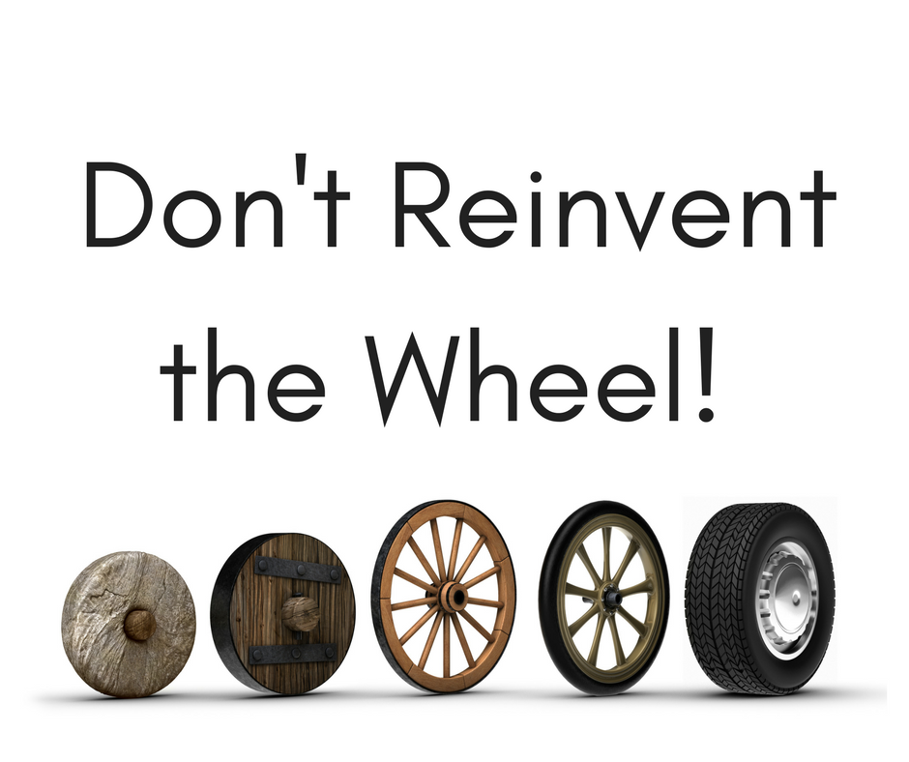
Guiding Principle

Slide 4
Bootcamp Style
https://colab.research.google.com/notebooks/intro.ipynb

Slide 5
5 LINES OF CODE
https://towardsdatascience.com/train-image-recognition-ai-with-5-lines-of-code-8ed0bdd8d9ba

Slide 6
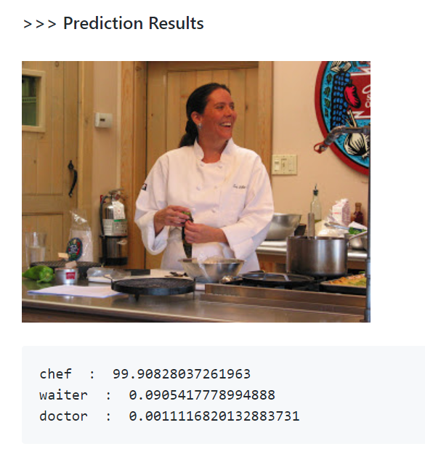
IdenProf
IdenProf dataset is a collection of images of identifiable professionals. It is been collected to enable the development of AI systems that can serve by identifying people and the nature of their job by simply looking at an image, just like humans can do.

Slide 7

Computer Vision
Fei-Fei Li: How do we teach computers to understand the visual world?
A computer scientist explores ‘the dark matter of our digital universe.’
The goal, says Li, are computers that not only discern, but understand visual content.
“They are the greatest share of data, but the least understood. [Images are] essentially invisible to us as digital information.”
The reason visual intelligence has lagged is not from a lack of effort—people have been trying since at least 1966. The fact is that computer vision is a profoundly difficult.
https://engineering.stanford.edu/magazine/article/fei-fei-li-how-do-we-teach-computers-understand-visual-world

Slide 8
Timeline for Computer Vision
1960
interpretation of synthetic worlds
1970
some progress on interpreting selected images
1980
ANNs come and go; shift toward geometry and increased mathematical rigor
1990
Face recognition; statistical analysis in vogue
2000
2010-Current
broader recognition; large annotated datasets available; video processing starts
self-driving cars, robotic and VR Computer vision started gaining a seat in daily life.
began in 1966(Minsky assigns computer vision as an undergrad summer project):
https://medium.com/@cetiner/computer-vision-101-861b148f29d4

Slide 9
Four hallmarks of true computer vision
Identifying Objects - Objects are the building blocks of vision. A computer must see an object and recognize for what it is. Much of vision is not really ‘seeing’ at all, but interpretation based upon our knowledge of the three-D world.
Recognizing People – Correct identification of specific people.
Classifying Actions- The third hurdle is to correctly describe the action in a photograph.
Telling Stories - The culmination is to understand what is going on in an image—to describe both the content and the context.

Slide 10

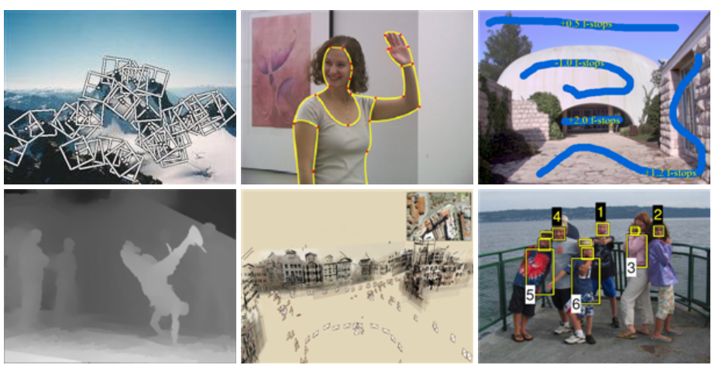
Resource: Free Download
http://szeliski.org/Book/

Slide 11
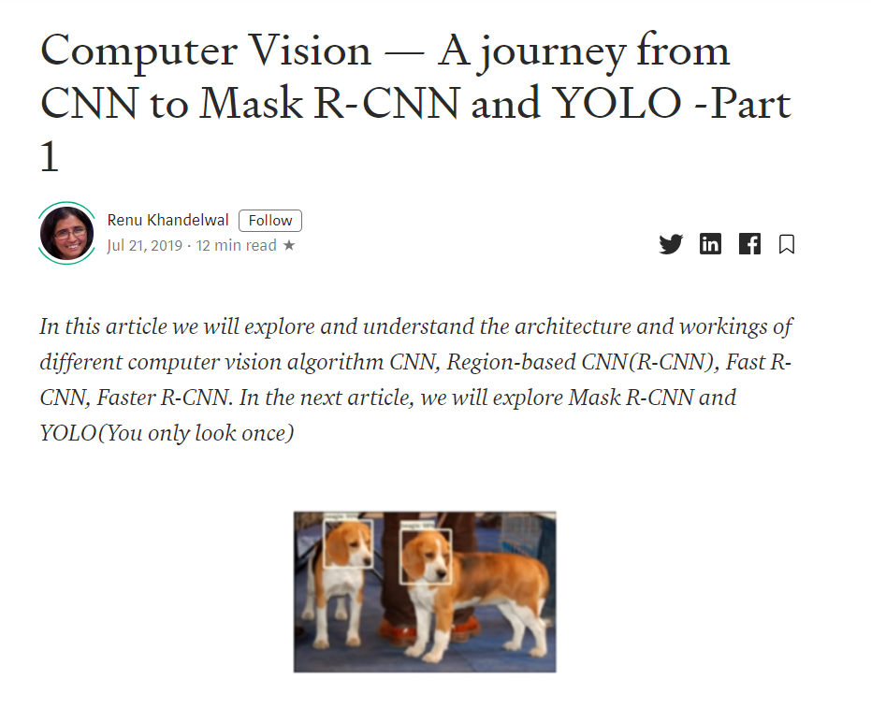
Intro – Resource
Computer Vision — A journey from CNN to Mask R-CNN and YOLO -Part 1
https://towardsdatascience.com/computer-vision-a-journey-from-cnn-to-mask-r-cnn-and-yolo-1d141eba6e04

Slide 12
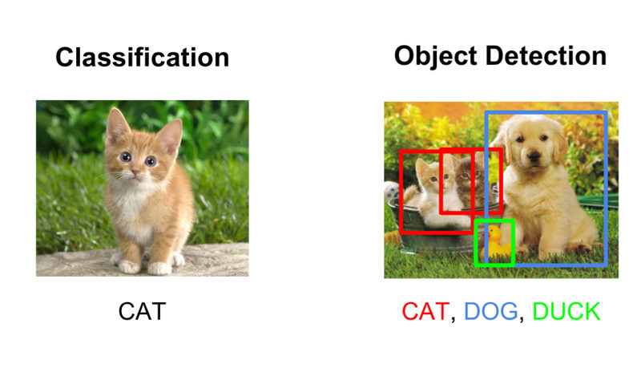
Classification vs Object Detection
https://www.datacamp.com/community/tutorials/object-detection-guide

Slide 13
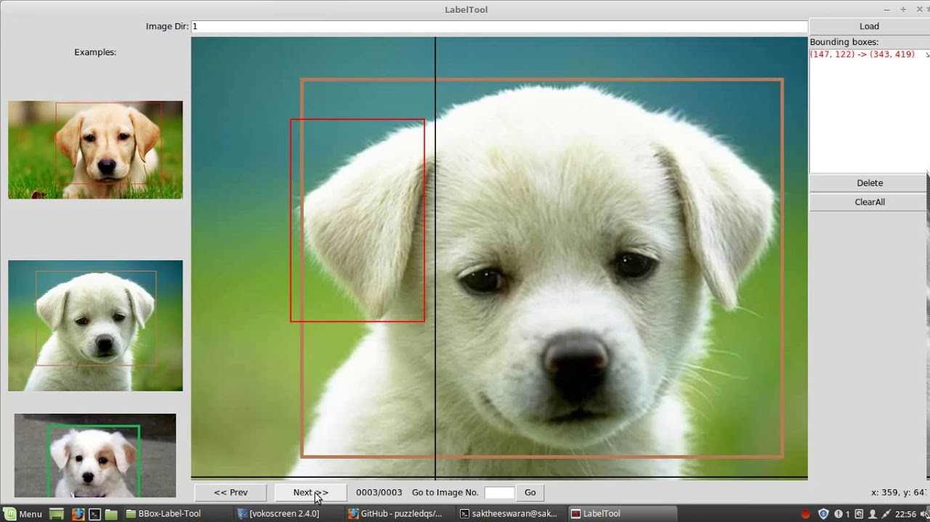
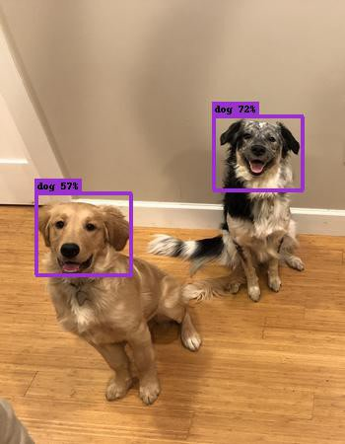
Label Data for Object Detection
The normalized bounding box coordinates for the dogs in the image are e.g. [0.1, 0.44, 0.34, 0.56] and [0.72, 0.57, 0.87, 0.77]

Slide 14
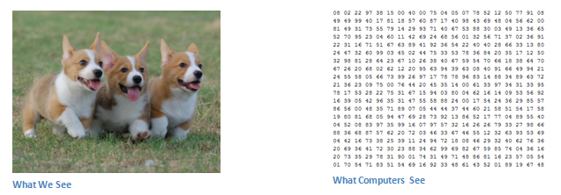
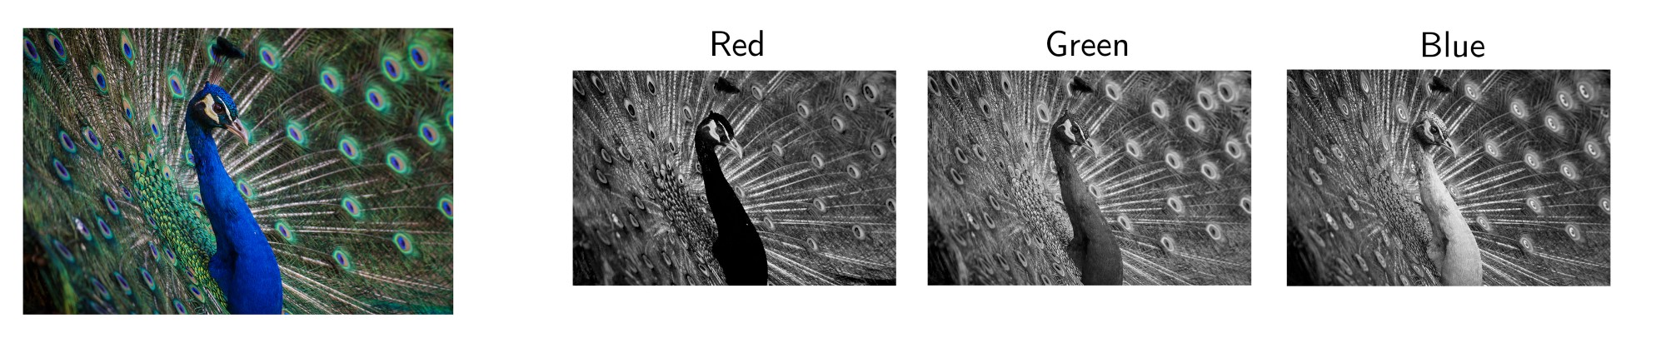
101 –Image Processing
https://adeshpande3.github.io/A-Beginner%27s-Guide-To-Understanding-Convolutional-Neural-Networks/

Slide 15
Inputs and Outputs
When a computer sees an image (takes an image as input), it will see an array of pixel values. Depending on the resolution and size of the image, it will see a 32 x 32 x 3 array of numbers (The 3 refers to RGB values).
If we have a color image in JPG form and its size is 480 x 480. The representative array will be 480 x 480 x 3. Each of these numbers is given a value from 0 to 255 which describes the pixel intensity at that point.
https://adeshpande3.github.io/A-Beginner%27s-Guide-To-Understanding-Convolutional-Neural-Networks/

Slide 16
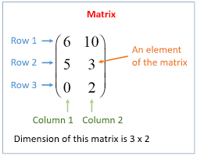
Matrix
A matrix consists of a set of numbers arranged in rows and columns enclosed in brackets.
https://www.onlinemathlearning.com/matrices-rows-columns.html

Slide 17
Convolution Networks
What we want the computer to do is to be able to differentiate between all the images it’s given and figure out the unique features that make a dog a dog or that make a cat a cat.
When we look at a picture of a dog, we can classify it as such if the picture has identifiable features such as paws or 4 legs. In a similar way, the computer is able perform image classification by looking for low level features such as edges and curves, and then building up to more abstract concepts through a series of convolutional layers.

Slide 18

Back to fundamental CONCEPTS
The advent of powerful and versatile deep learning frameworks in recent years has made it possible to implement convolution layers into a deep learning model an extremely simple task, often achievable in a single line of code.
https://towardsdatascience.com/intuitively-understanding-convolutions-for-deep-learning-1f6f42faee1

Slide 19
Kernels
An image kernel is a small matrix used to apply effects like the ones you might find in Photoshop or Gimp, such as blurring, sharpening, outlining or embossing.
Kernels combine pixels only from a small, local area to form an output. That is, the output feature only “sees” input features from a small local area. The kernel is applied globally across the whole image to produce a matrix of outputs.
Image Kernels
Explained Visually
https://setosa.io/ev/image-kernels/

Slide 20
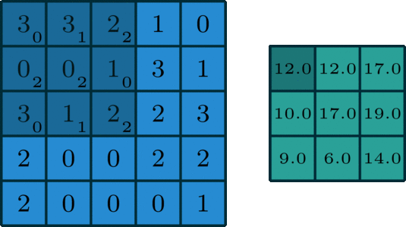
Kernel Operations in 2d
The 2D convolution is a fairly simple operation at heart: you start with a kernel, which is simply a small matrix of weights. This kernel “slides” over the 2D input data, performing an elementwise multiplication with the part of the input it is currently on, and then summing up the results into a single output pixel.

Slide 21
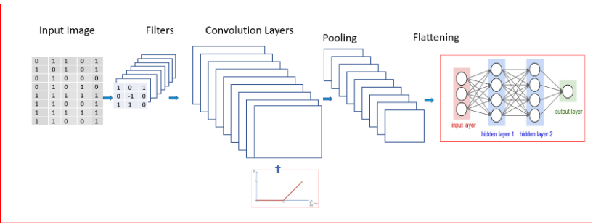
Workflow of a CNN
Limitations of CNN
Used for objection detection using bounding boxes but for only one object at a time
Don’t work well when multiple objects are in the visual field due to interference.
Strength of CNN
CNN is used for
Image classification
Objection detection using bounding boxes

Slide 22
Algoritms for Image Processing
With the emergence of powerful computers such as the NVIDIA GPUs and state-of-the-art Deep Learning algorithms for image recognition such as AlexNet in 2012 by Alex Krizhevsky et al, ResNet in 2015 by Kaeming He et al, SqueezeNet in 2016 by Forrest Landola et al, DenseNet in 2016 by Gao Huang et al, to mention a few, it is possible to put together a number of pictures (more like image books for computers) and define an artificial intelligence model to learn features of scenes and objects in these pictures by itself and use the knowledge gained from the learning process to recognize all other instance of the type of scene or objects it will encounter after.
https://towardsdatascience.com/train-image-recognition-ai-with-5-lines-of-code-8ed0bdd8d9ba

Slide 23

Public Data sets
The Microsoft Common Objects in Context (MS COCO) dataset - for detecting and segmenting objects found in everyday life in their natural environments contains 91 common object categories with 82 of them having more than 5,000 labeled instances.
http://cocodataset.org/#home

Slide 24

PASCAL VOC dataset
A decade or so ago, computer vision experts began an effort known as the PASCAL Visual Object Challenge to define 20 classes of objects ranging from vehicles and animals to household objects.

Slide 25

Public Datasets
“How many objects there are in the world, I don’t know,” Li says rhetorically before adding: “But, I know it’s more than 20. I have more than 20 objects in my office.”
Visual ObjectChallenge has begun to shift priorities to think on the order of millions of discrete objects. It took almost 50,000 workers from 167 countries a full two-and-a-half years to clean, sort, label, and cull through a database of a billion images.
https://www.votchallenge.net/

Slide 26
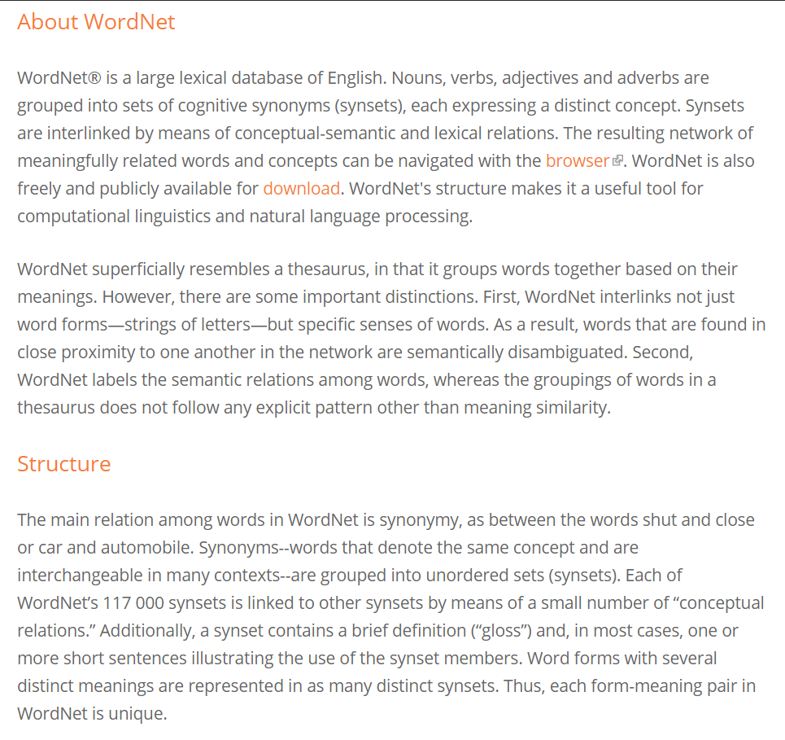
Wordnet to ImageNet
https://wordnet.princeton.edu/
http://www.image-net.org/index

Slide 27
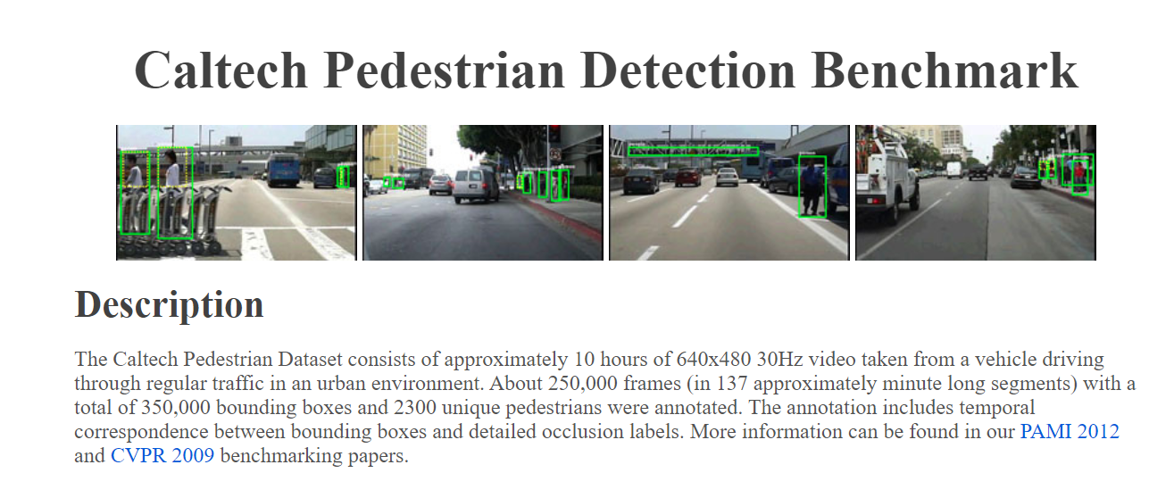
Caltech Pedestrian Detection Benchmark
Another popular challenge is the detection of pedestrians for which several datasets have been created. The Caltech Pedestrian Dataset [1] contains 350,000 labeled instances with bounding boxes.
http://www.vision.caltech.edu/Image_Datasets/CaltechPedestrians/

Slide 28

Recomended Resource
Practical Deep Learning for Coders, v3 - https://course.fast.ai/

Slide 29
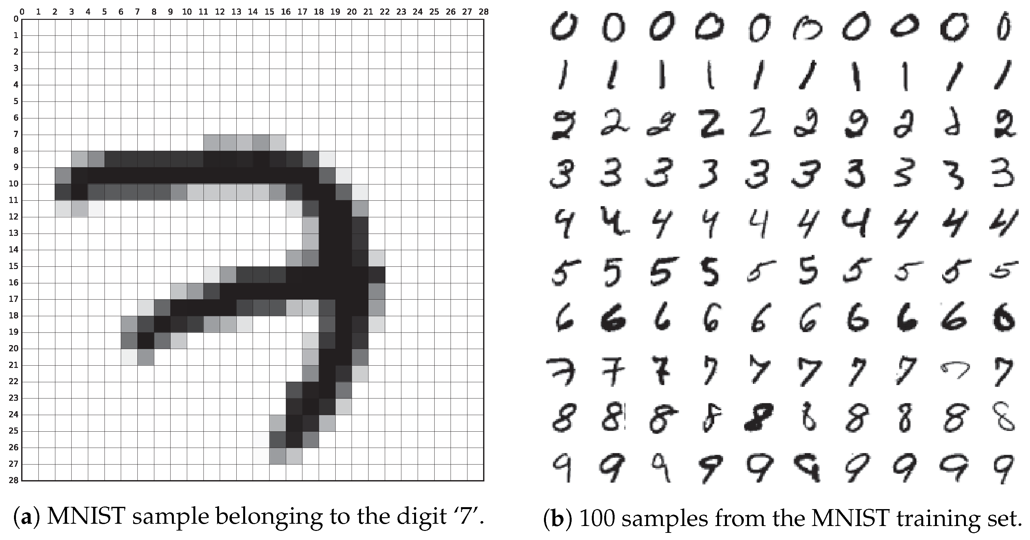



Simplicity
path = untar_data(URLs.MNIST_SAMPLE) data = ImageDataBunch.from_folder(path) learn = cnn_learner(data, models.resnet18, metrics=accuracy) learn.fit(1)
https://docs.fast.ai/

Slide 30
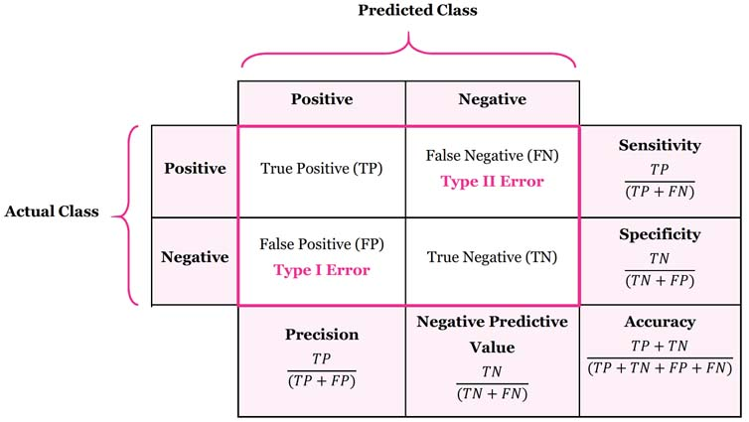
Key Concepts to Evaluate Models
https://manisha-sirsat.blogspot.com/2019/04/confusion-matrix.html

Slide 31
Key Takeaways on Confusion Matrix
Classification Accuracy: Overall, how often is the classifier correct?
Classification Error: Overall, how often is the classifier incorrect?
Sensitivity: When the actual value is positive, how often is the prediction correct? - Also known as "True Positive Rate" or "Recall"
Specificity: When the actual value is negative, how often is the prediction correct?

Slide 32
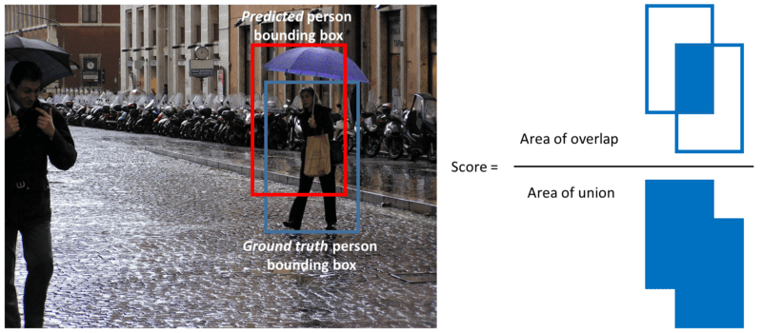
Evaluation – Object Detection
The most common evaluation metric that is used in object recognition tasks is ‘mAP’, which stands for ‘mean average precision’.
Note that a detection is a true positive if it has an ‘intersection over union’ (IoU or overlap) with the ground-truth box greater than some threshold (usually 0.5). Instead of using mAP we typically use mAP@0.5 or mAP@0.25 to refer to the IoU that was used.
https://www.datacamp.com/community/tutorials/object-detection-guide

Slide 33
Survey Contributions
This survey focuses on describing and analyzing deep learning based object detection task. The existing surveys always cover a series of domain of general object detection and may not contain state-of-the-art methods which provide some novel solutions and newly directions of these tasks due of the rapid development of computer vision research.
(1) This paper lists very novel solutions proposed recently but neglects to discuss the basics so that readers can see the cutting edge of the field more easily
(2) Moreover, different from previous object detection surveys, this paper systematically and comprehensively reviews deep learning based object detection methods and most importantly the up to date detection solutions and a set of significant research trends as well.
(3) This survey is featured by in-depth analysis and discussion in various aspects, many of which, to the best of our knowledge, are the first time in this field. Above all, it is our intention to provide an overview how different deep learning methods are used rather than a full summary of all related papers.

Slide 34
Object Detectors
Two categories of Object Detectors :
Two-stage detectors Faster R-CNN is the most representative - the most representative one
One-stage detectors such as YOLO [9], SSD
Two-stage detectors have high localization and object recognition accuracy, whereas the one-stage detectors achieve high inference speed.

Slide 35
Two Stage
The two stages of two-stage detectors can be divided by RoI (Region of Interest) pooling layer
For instance, in Faster R-CNN, the first stage, called RPN, a Region Proposal Network, proposes candidate object bounding boxes. The second stage, features are extracted by RoIPool (RoI Pooling) operation from each candidate box for the following classification and bounding-box regression tasks

Slide 36
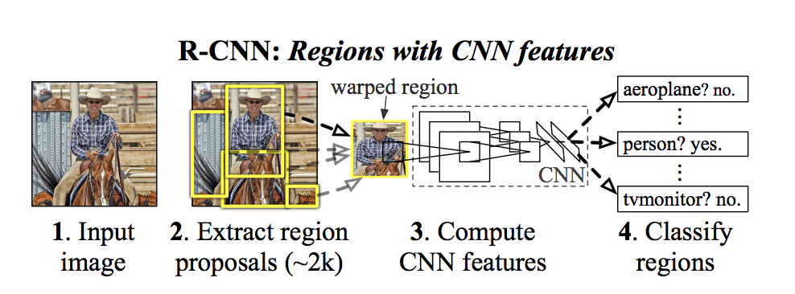
R-CNN
R-CNN is a region based CNN detector
R-CNN which can be used in object detection tasks, their works are the first to show that a CNN could lead to dramatically higher object detection performance on PASCAL VOC datasets [4] than those systems based on simpler HOG-like featuresDeep learning method is verified effective and efficient in the field of object detection

Slide 37
Fast R-CNN
Because R-CNN performs a ConvNet forward pass for each region proposal without sharing computation, R-CNN takes a long time on SVMs classification.
Because R-CNN performs a ConvNet forward pass for each region proposal without sharing computation, R-CNN takes a long time on SVMs classification. Fast RCNN extracts features from an entire input image and then passes the region of interest (RoI) pooling layer to get the fixed size features as the input of the following classification and bounding box regression fully connected layers.
Another improvement is that Fast R-CNN uses a RoI pooling layer to extract a fixed size feature map from region proposals of different size.

Slide 38
Results
Experiment results showed that Fast R-CNN had 66.9% mAP while R-CNN of 66.0% on PASCAL VOC 2007 dataset [4]. Training time dropped to 9.5 hours as compared to RCNN with 84h, 9 times faster.
For test rate (s/image), Fast R-CNN with truncated SVD (0.32s) was 213 faster than RCNN (47s). These experiments were carried out on an Nvidia K40 GPU, which demonstrated that Fast R-CNN did accelerate object detection process.

Slide 39
FASTER R-CNN
Faster R-CNN: Three months after Fast R-CNN was proposed, Faster R-CNN [8] further improves the region-based CNN baseline.
Faster R-CNN replaces it with a novel RPN (region proposal network) that is a fully convolutional network to efficiently predict region proposals with a wide range of scales and aspect ratios. RPN accelerates the generating speed of region proposals because it shares fully-image convolutional features and a common set of convolutional layers with the detection network.

Slide 40
FASTER CNN
Experiments indicated that Faster R-CNN has greatly improved both precision and detection efficiency. On PASCAL VOC 2007 test set, Faster R-CNN achieved mAP of 69.9% as compared to Fast R-CNN of 66.9% with shared convolutional computations.
As well, total running time of Faster R-CNN (198ms) was nearly 10 times lower than Fast R-CNN (1830ms) with the same VGG [26] backbone, and processing rate was 5fps vs. 0.5fps.

Slide 41

YOLO
YOLO: YOLO [9] (you only look once) is a one-stage object detector proposed by Redmon et al. after Faster RCNN [8]. The main contribution is real-time detection of full images and webcam.
Secondly, YOLO frames detection as a regression problem, so a unified architecture can extract features from input images straightly to predict bounding boxes and class probabilities. YOLO network runs at 45 frames per second with no batch processing on a Titan X GPU as compared to Fast R-CNN at 0.5fps and Faster R-CNN at 7fps.

Slide 42
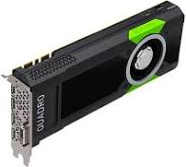
GPU
What are GPUs ?
GPU(Graphics Processing Unit) is considered as heart of Deep Learning, a part of Artificial Intelligence. It is a single chip processor used for extensive Graphical and Mathematical computations which frees up CPU cycles for other jobs.

Slide 43
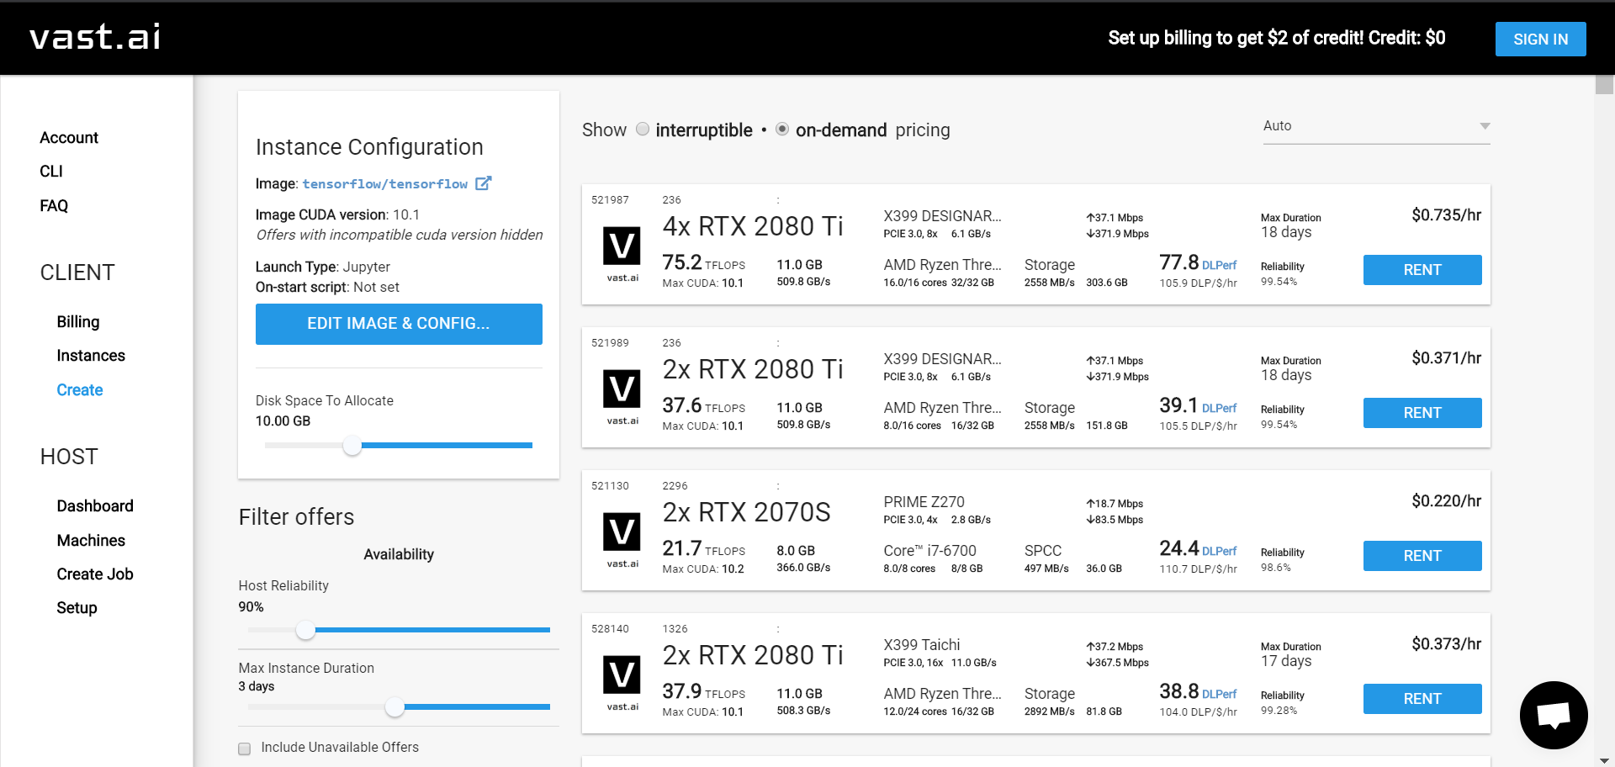
GPU
https://vast.ai/

Slide 44
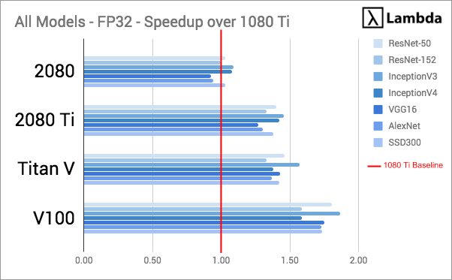
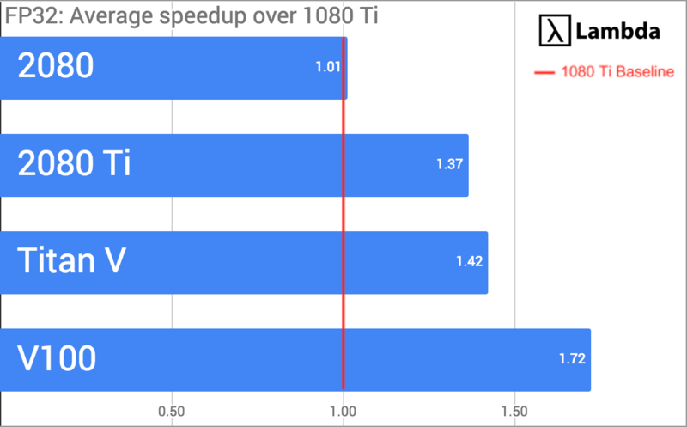
GPU
https://lambdalabs.com/blog/best-gpu-tensorflow-2080-ti-vs-v100-vs-titan-v-vs-1080-ti-benchmark/
Ocelote has 45 compute nodes with Nvidia P100 GPU's.

